Slide 1

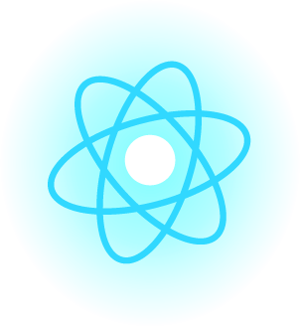
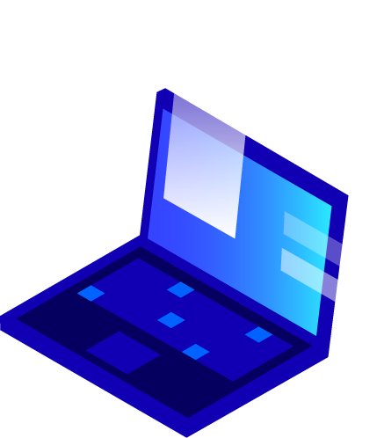


Introduction to C Programming Language

Slide 2
What is Programming ?
Computer programming is the process of designing and building an executable computer program to accomplish a specific computing result or to perform a specific task.
It’s a way to talk to computer.

Slide 3
What is C Language ?
C is a general-purpose, procedural computer programming language supporting structured programming, lexical variable scope, and recursion, with a static type system. By design, C provides constructs that map efficiently to typical machine instructions.

Slide 4
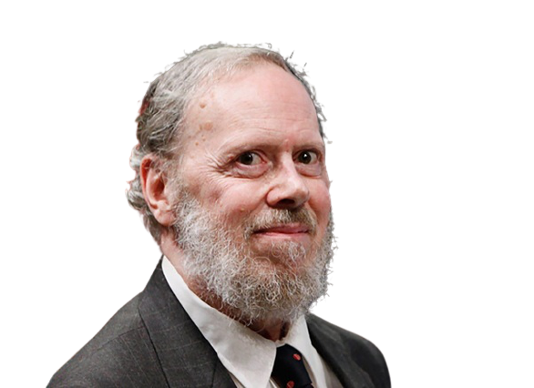
Who Invented C ?
C language developed in the early 1970s by American computer scientist Dennis M. Ritchie at Bell Laboratories

Slide 5
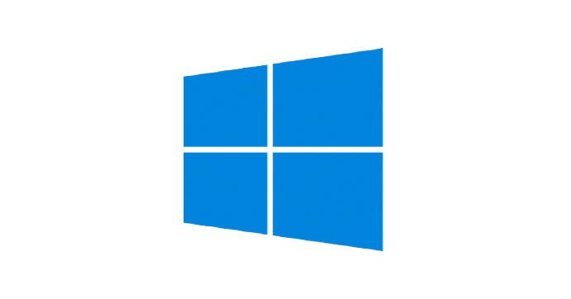

Where we use C ?
C language is widely used in embedded systems. It is used for developing system applications. It is widely used for developing desktop applications. Most of the applications by Adobe are developed using C programming language.
Our Operating systems most of the parts are written in C.
Even MySQL database is written in C.

Slide 6

Why to learn C ?
C builds our Programming foundation.

Slide 7
Characteristics of C
General Purpose
Structured
Case sensitive
High level
Platform independent
Architecture neutral
Fast
Typed
Standardized

Slide 8
Thank You

